Slide 1


Polio Tech Guard: A Digital Solution
The current system for polio vaccination, relying on anganwadis and clinics, faces significant challenges. Parents must travel to designated facilities, often encountering long queues, potentially delaying or missing crucial vaccinations. Many individuals lack awareness of polio, its impact, and the importance of vaccination. Additionally, maintaining hard-copy records poses difficulties in terms of tracking and accuracy.
MJ
by Mubbassir Khan Jahagirdar

Slide 2
Current System Inefficiencies
Time Constraints
Lack of Awareness
Recordkeeping Challenges
Parents often face scheduling conflicts, limiting their availability for clinic visits. Long wait times at clinics add further strain, impacting parents' ability to reach appointments on time.
Many individuals lack basic understanding of polio, its potential consequences, and the benefits of vaccination. This gap in knowledge hinders informed decision-making and contributes to vaccine hesitancy.
Maintaining physical vaccination records can be cumbersome, prone to errors, and difficult to access for monitoring purposes. This creates inefficiencies in tracking individual vaccination progress and identifying potential gaps in coverage.

Slide 3


Transforming Polio Vaccination with Digital Solutions
Centralized Data Management
Leveraging existing hospital data, such as birth certificates, allows for a centralized database that stores crucial information about each child, facilitating efficient tracking and communication.
AI-powered Voice Bot
An AI-powered voice bot interacts with parents, providing timely reminders about vaccination schedules, fostering proactive engagement and improving adherence to recommended vaccination timelines.
User-friendly Website
A user-friendly website provides parents with convenient access to their child's vaccination records, allowing them to track progress, receive notifications, and access relevant information about polio.
Community Education
Regular meetings at anganwadis focus on raising awareness about polio, its impact, and the importance of vaccination, equipping communities with the knowledge to make informed decisions.

Slide 4





AI-powered Voice Bot: Proactive Engagement
Personalized Reminders
The AI-powered voice bot uses a child's vaccination schedule to send automated reminders to parents, ensuring timely appointments and preventing missed vaccinations.
Interactive Communication
The voice bot engages in conversations with parents, answering questions, providing clarification, and addressing concerns, fostering trust and confidence in the vaccination process.
Language Support
The voice bot is equipped with language support, ensuring clear communication with parents across diverse linguistic backgrounds, promoting inclusivity and accessibility.

Slide 5
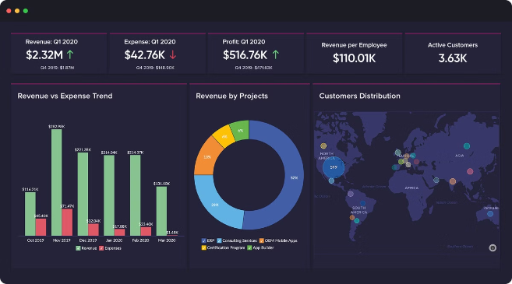
Centralized Data Platform: Enhanced Efficiency
Feature
Benefits
Secure Data Storage
Protects sensitive information, ensuring confidentiality and compliance with privacy regulations.
Real-time Access
Provides healthcare professionals with instant access to updated vaccination records, facilitating informed decision-making and efficient management.
Data Analytics
Allows for in-depth analysis of vaccination trends, identifying areas for improvement and optimizing resource allocation.

Slide 6

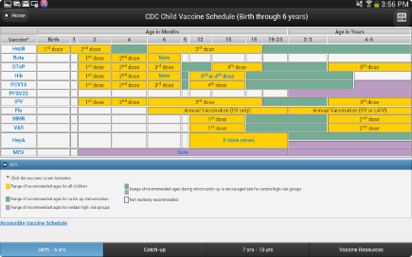
User-friendly Website: Empowered Parents
1
Vaccination Schedule Tracking
2
Personalized Notifications
Parents can easily access and monitor their child's vaccination schedule, ensuring they stay informed about upcoming appointments.
The website sends timely reminders, notifications about missed appointments, and updates regarding vaccination progress.
3
Educational Resources
4
Contact Information
Parents can access comprehensive information about polio, its causes, symptoms, and the importance of vaccination, fostering informed decision-making.
The website provides contact information for healthcare professionals, allowing parents to seek clarification, address concerns, and schedule appointments.

Slide 7






Community Education: Fostering Trust and Understanding
Interactive Sessions
Regular meetings at anganwadis feature interactive sessions, utilizing visual aids and engaging discussions to educate communities about polio and vaccination.
Addressing Concerns
These sessions provide a platform for parents to ask questions, raise concerns, and gain accurate information about polio and vaccination.
Building Trust
Open dialogue and community engagement foster trust and understanding, overcoming misconceptions and promoting widespread vaccination acceptance.
Community Mobilization
These sessions encourage community participation, empowering individuals to become advocates for polio eradication and vaccination within their own communities.

Slide 8


Impact: Transforming Lives Through Enhanced Vaccination Coverage
1
Increased Vaccination Coverage
Proactive engagement through voice bots and user-friendly websites ensures timely appointments and reduces missed vaccinations, leading to improved coverage rates.
2
Improved Health Outcomes
Higher vaccination coverage translates into reduced incidence of polio, safeguarding children's health and well-being.
3
Stronger Communities
Empowered communities with increased knowledge and understanding of polio are better equipped to prevent outbreaks and build a healthier future for all.

Slide 9



Sustainable Solutions: Integrating Technology and Community Engagement
Mobile-first Approach
Data Integration with Health Systems
Community Ownership
Utilizing a mobile-first approach ensures accessibility for individuals in rural areas with limited internet access, maximizing outreach and impact.
Engaging community leaders and volunteers in the implementation and maintenance of the digital solution fosters ownership and ensures sustainability.
Integrating the digital platform with existing health systems allows for seamless data sharing and coordination, streamlining vaccination efforts.

Slide 10


Conclusion: Towards a Polio-free Future
By leveraging technology and promoting community engagement, we can create a more effective and sustainable polio vaccination program. This digital solution not only addresses existing challenges but also empowers parents, healthcare professionals, and communities to work together towards a polio-free future for all.

